Slide 1


Final Project – Data Science Bootcamp
Customer Churn Prediction
By Adrian Maulana Muhammad

Slide 2


Table of Contents
Business & Data Understanding
Data Description
Exploratory Data Analysis (EDA) & Statistical Analysis
Data Pre-processing
Machine Learning Model
Model Evaluation
Summaries & Recommendations
References

Slide 3
Part I
Business & Data Understanding

Slide 4

Competition in Telecommunication Industry
The telecommunications industry is rapidly growing, as evidenced by the changing behavior of consumers who increasingly rely on internet communication. The increased number of telecommunication companies and internet service providers has created intense competition, which gives customers the power to choose their preferred provider. This means that customers can switch providers, a phenomenon referred to as Customer Churn. This switch can lead to a decrease in revenue for telecom companies, making it imperative to address this issue.

Slide 5

Customer Churn
Customer Churn is when customers switch from one telecom provider to another, decreasing revenue for the original provider. To address Customer Churn, telecom companies must understand their drivers, improve service quality, offer competitive pricing, and provide additional benefits to retain customers. Addressing Customer Churn is important for maintaining a competitive advantage and ensuring success in the telecommunications industry.

Slide 6
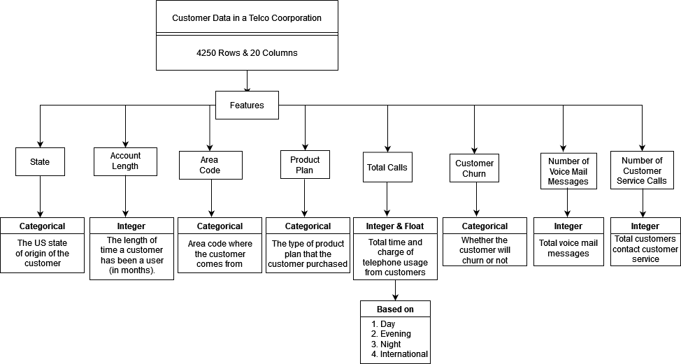
Data Understanding

Slide 7
Part II
Data Observation

